Slide 1
Project: Classification of DME & AMD from OCT Images using CNN Name: Saad Iqbal

Slide 2
Problem Statement and Assumptions
To design a system for the identification and classification of OCT Scans of patients suffering from Age-Related Macular Degeneration (AMD) and Diabetic Macular Edema (DME) from Normal Patients
Assumptions:
Dataset images does not require De-Noising to achieve desired accuracy
Given small dataset prone to Overfitting & low accuracy on prediction
Greyscale medical images: Average Pooling in CNN
Image Augmentation is risky due to lack of domain knowledge

Slide 3
Objective
To achieve 99.67 Percent Accuracy using the custom model and 75 per cent using Transfer Learning Model.

Slide 4
Insights from the Data
Total Images: 3231
AMD: 723
DME: 1101
Normal: 1407

Slide 5
Data Preprocessing Steps
Custom CNN Model
Open CV used to read the tif images & convert them to Greyscale
Resized images to 128 x 128
Converted these to floating point tensors
Rescale the pixel values (between 0 and 255)
Flatten the images into a list of raw pixel intensities
Converted the labels to binary matrix using to_Categorical for use with categorical crossentropy
Test data allocation was set at 20%

Slide 6
Data Preprocessing Steps
2- Pretrained VGG16 without Image Augmentation
To get 3 class labels only for the entire dataset. All images were renamed and for each class’s 15 folders were merged into single class respectively.
These 3 folders were then split into train, validation and test sets using splitfolder function as per following:
Train image dataset: 2260 (distributed in 3 classes)
Validation image dataset: 322 (distributed in 3 classes)
Test image dataset: 649 (distributed in 3 classes)
For image Pre-processing used ImageDataGenerator class from module keras.preprocessing.image for
Tif image reading in batches of 20
Resizing to 150 x150
Converted to RGB to used with VGG16
Normalization of image pixles
Converting the labels to binary matrix
Flattened the tensors

Slide 7
Data Preprocessing Steps
3- Pretrained VGG16 with Image Augmentation
To get 3 class labels only for the entire dataset. All images were renamed and for each class’s 15 folders were merged into single class respectively.
These 3 folders were then split into train, validation and test sets using splitfolder function as per following:
Train image dataset: 2260 (distributed in 3 classes)
Validation image dataset: 322 (distributed in 3 classes)
Test image dataset: 649 (distributed in 3 classes)
Used ImageDataGenerator for Image Augmentation ( rescale= 1./255, zoom_range= (0.73, 0.9), horizontal_flip= True, rotation_range= 10, width_shift_range= 0.10, fill_mode= 'constant', height_shift_range= 0.10, brightness_range= (0.55, 0.9))
For image Pre-processing used ImageDataGenerator class from module keras.preprocessing.image for
Tif image reading in batches of 32
Resizing to 150 x150
Converted to RGB to used with VGG16
Converting the labels to binary matrix

Slide 8
Algorithms used for Modeling
Model 1: Custom CNN - Test Accuracy = 99.69%
Conv2D 3x3 filters: 32, 64, 128
Dense layers: 128, 64, 32, 16, 8, 3
Average Pooling (2x2)
Batch Normalization, Dropout, L2 regularization
Activation: Relu, Softmax
Optimizer: Adam with learning rate= 0.0001
Cost function: Categorical Crossentropy
To achieve higher accuracy we used deep network, this alongwith smaller dataset was prone to overfitting, so we used stringent measure to minimize the possible overfitting. We had to train the model on epochs = 60
Code Link: https://github.com/SaadIqbalGH/Deep-Learning-CNN-Transfer-Learning/blob/main/OCT_Retina_Custom%20CNN.ipynb

Slide 9
Algorithms used for Modeling
Model 2: VGG16 without Augmentation, Test Accuracy = 99.23%
Dense layers: 256, 3
Dropout
Activation: Relu, Softmax
Optimizer: rmsprop
Cost function: Categorical Crossentropy
Epochs = 20
Code Link:
https://github.com/SaadIqbalGH/Deep-Learning-CNN-Transfer-Learning/blob/main/OCT_Retina_VGG16%2BBottleneck_Features_Extraction_without_Augmentation.ipynb

Slide 10
Algorithms used for Modeling
Model 3: VGG16 with Augmentation, Test Accuracy = 96.46%
Dense layers: 256, 3
Dropout
Activation: Relu, Softmax
Optimizer: rmsprop
Cost function: Categorical Crossentropy
Epochs = 20
Codel Link:
https://github.com/SaadIqbalGH/Deep-Learning-CNN-Transfer-Learning/blob/main/OCT_Retina_VGG16%2BImageAugmentation.ipynb

Slide 11
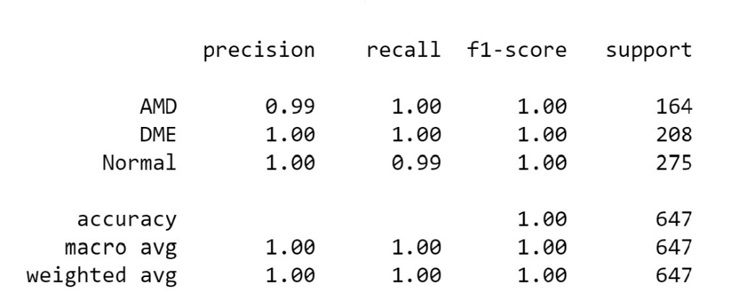
Results – Model 1
Model 1: Custom CNN - Test Accuracy = 99.69%

Slide 12
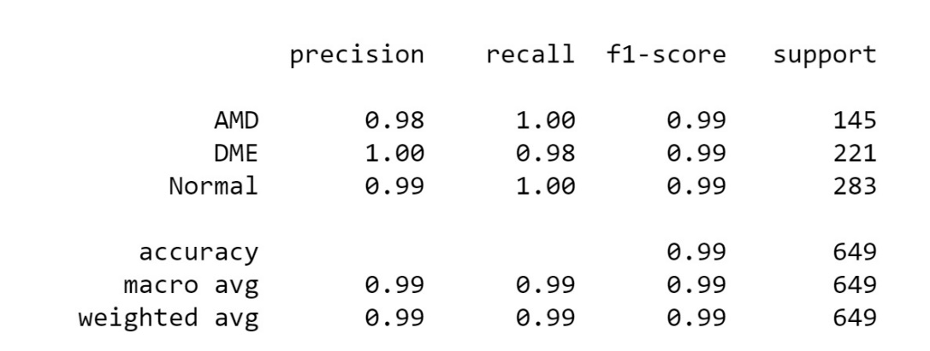
Results – Model 2
Model 2: VGG16 without Augmentation, Test Accuracy = 99.23%

Slide 13
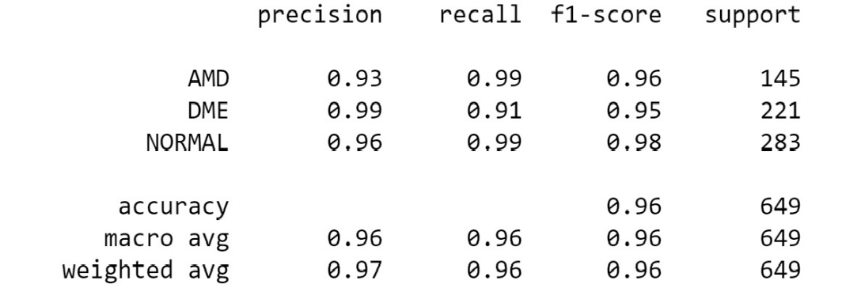
Results - Model 3
Model 3: VGG16 with Augmentation, Test Accuracy = 96.46%

Slide 14
Future Improvement
Deal with Class Imbalance using RandomunderSampler
Reduce noise from images using Auto Encoders (CNN-guided BM3D-Net)
Map grayscale images to RGB color space using the HSV color map
Fine tuning VGG16 results to achieve same results on less number of epochs
Unfroze model weights
Reduced learning rate
Experiment with other optimizers and other pre-trained models such as EfficientNet, ResNet, InceptionResNetV2 etc.
Use Ensemble models
Notes:
nc

